Slide 1
JWST’s Cryogenic Position Metrology System
ITT Exelis: Tony L.Whitman, Thomas Scorse, Keith A. Havey, Jr
Johns Hopkins University: Randolph P. Hammond, Joe Orndorff, Stephen Hope, Stephen A. Smee
SPIE 8442 – 91
July 6, 2012

Slide 2
Agenda
Introduction
Motion Design
Window Design
Flash Improvements

Slide 3
Cryogenic Optical Test Configuration of JWST
Center of Curvature Optical Assembly (COCOA)
Interferometer, null, calibration equipment
Coarse/fine PM phasing tools
Displacement Measuring Interferometer
Photogrammetry
4 camera windmills
Targets and codes
Scale Bars
3 Autocollimating Flat Mirrors
Piston and Tilt actuation
LN2 and Helium Cryogenic Shrouds and “barn door”
Absolute Distance Meter
Optical Test Point Sources at intermediate telescope focus

Slide 4
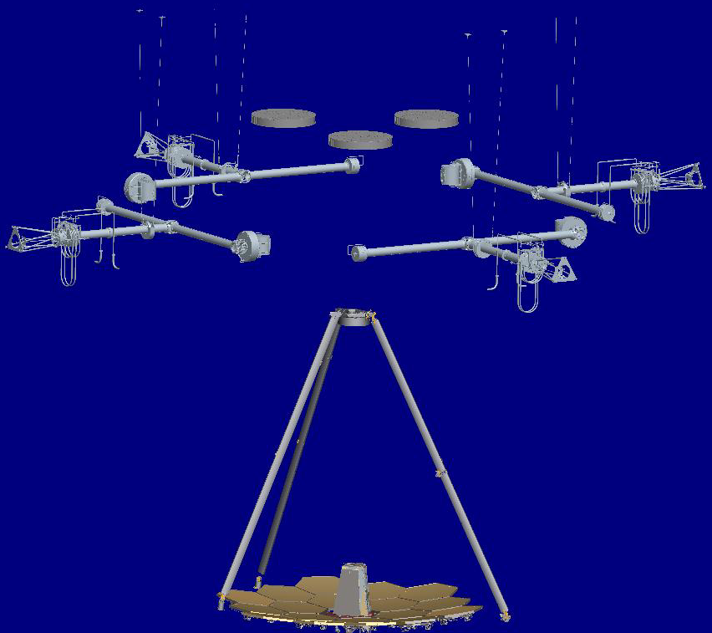
Camera Windmill Configuration
3 Flat mirrors for auto-collimation
4 Windmills Each with 1 Camera inside canister at end of 3.4 m radius boom
JWST

Slide 5
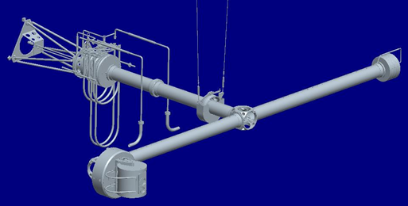
Windmill Assembly
Drive Motor
Shaft
Counter weight
Plumbing take-up reel
Rotating
Boom
Canister with Camera

Slide 6
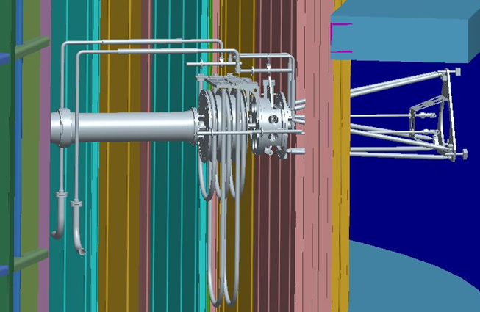
Relation to Cryogenic Walls
Pressure wall
Cryogenic Helium wall
Liquid Nitrogen wall

Slide 7
Boom Drive Gear Motor
Resolver
Stepper Motor
~ 100 K
Limit Switch Assembly
w/ Ti flexure
Worm Gear
180: 1 ratio
Worm
w/ Teflon anodize coating
Inertia-Matching Mass

Slide 8
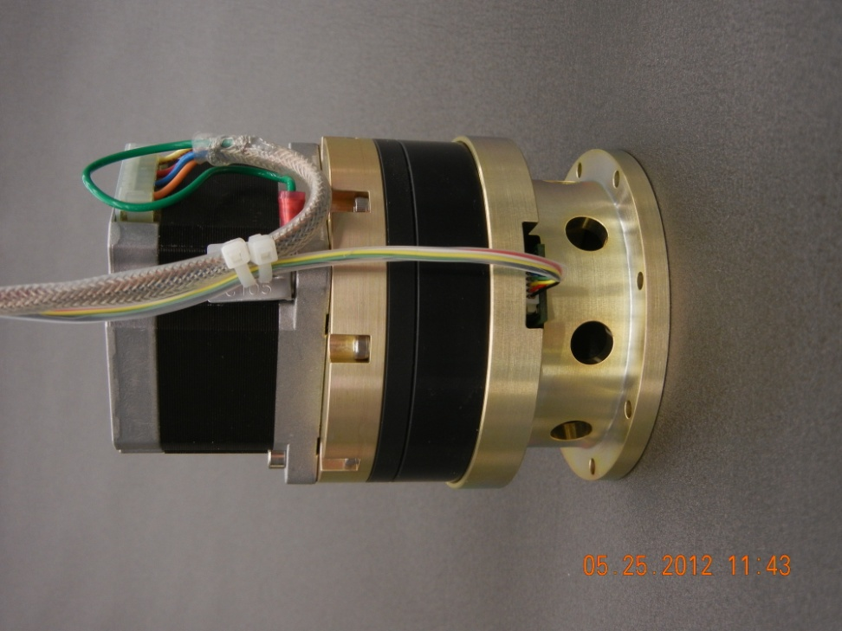
Canister Motions
Camera Roll
90°
INCA-3 Camera
Tilt-Axis Drive Motor
291 K
Camera Roll Motor
Tilt Axis
+60° / - 75°
Yoke
Worm Gear
~ 20 K
Pan-Axis Shaft
Delrin plugs maintain snug during full temperature range
Feed thru for electrical cables
Pan Axis
+/- 60°

Slide 9
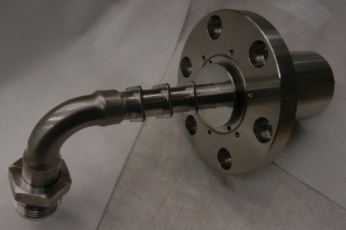
Tilt Drive
Harmonic Drive Gearhead
Ferro-Fluidic Feedthrough
Stepper Motor
(warm side)
Gaseous Nitrogen Purge Inlet
Limit Switch Assembly
Canister

Slide 10
Camera Drive
INCA-3 Camera
Harmonic Drive Gearhead
Stepper Motor
Power Distribution and Communication Board
Temperature Sensor Board
All drive electronics at this board level
Only power and Ethernet travel long boom distance

Slide 11
Window design

Slide 12
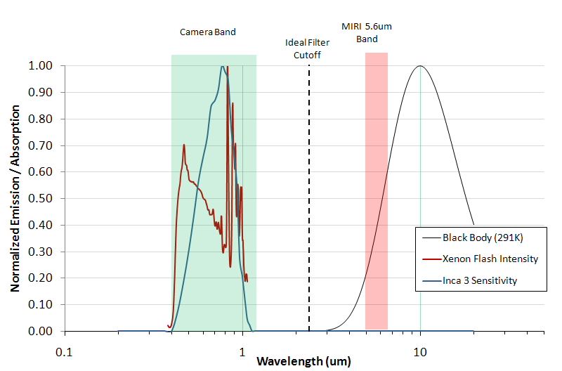
Flash and Camera Spectral Ranges

Slide 13
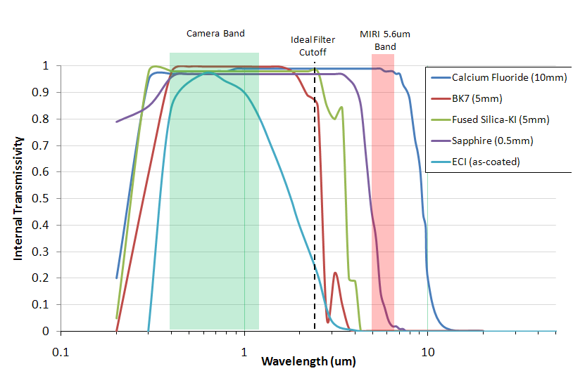
Material / Coatings Internal Transmissivity
Sapphire and CaFl are not very effective FIR filters
BK7, Fused Silica, and several commercially available optical coatings are effective

Slide 14
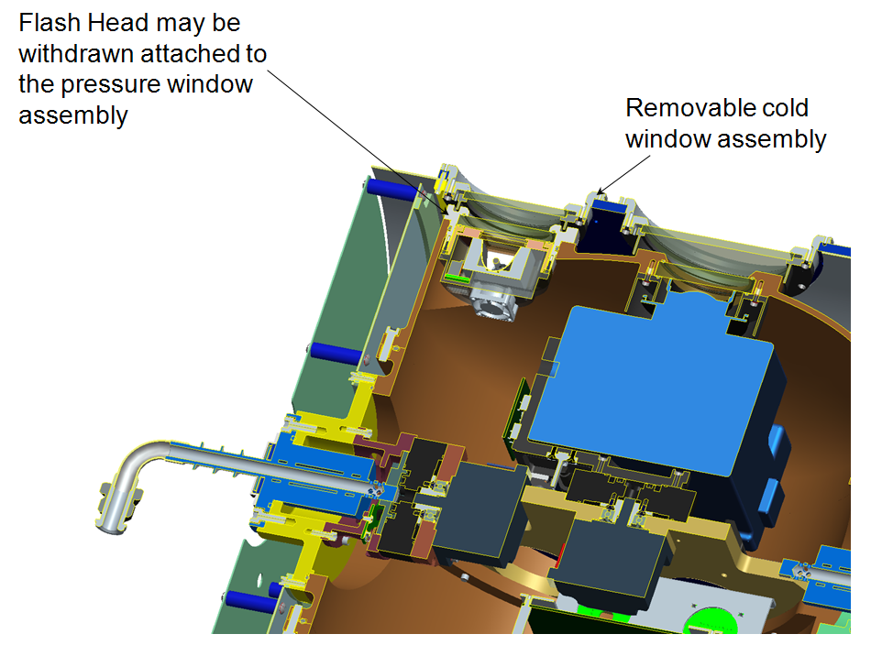
Double Window for Flash and Camera
Colder outer vacuum windows
Warm inside pressure windows
Flash
Camera

Slide 15
Window Material & Coatings
Chamber
Visible AR coating
BK7 “filter” window
(T ≈ 30K)
Visible Anti-Reflective (AR) coating
Custom Infrared
Reflective Coating
BK7 Pressure window
(T ≈ 291K)
Camera
Visible AR coating
Transmission Stack-Up Reflectance / Absorption
BK7 window (w/ 2 sided AR coatings): 0.98 Reflective Coating film is 85%
BK7 window (w/ 1 sided AR coating): 0.99 reflective at wavelengths > 5μm
BK7 is 100% absorptive at wavelengths > 4μm

Slide 16
Stray Light and Thermal Performance
Transmission rate above 4μm for the cold window (BK7 w/ reflective coating) is essentially zero
A small amount of radiant energy is emitted from the cold window itself
Stray light emission rate estimates are:
NIRCam 0.6-2.3 μm = 0.16 μW
NIRCam 2.3-5.0 μm = 5.13 μW
MIRI 5-6.2 μm = 0.89 μW
MIRI 5-27 μm = 27.01 μW
Thermal emission rate estimate:
Thermal 2-100 μm = 0.64 mW
Compare to 1.1 μW emission requirement
Compare to 6 mW emission requirement

Slide 17
FLASH

Slide 18
Example Flash Performance 100 k flashes planned for JWST Tests
Average life 64, 000 flashes

Slide 19
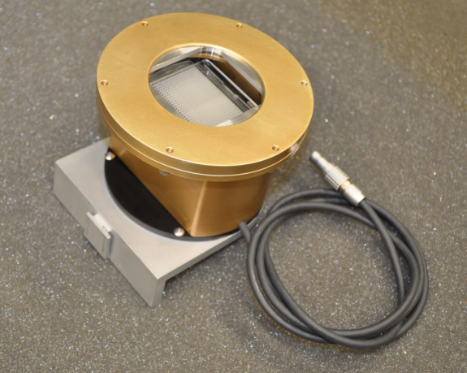
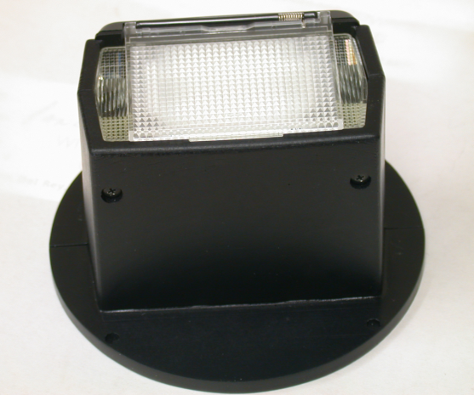
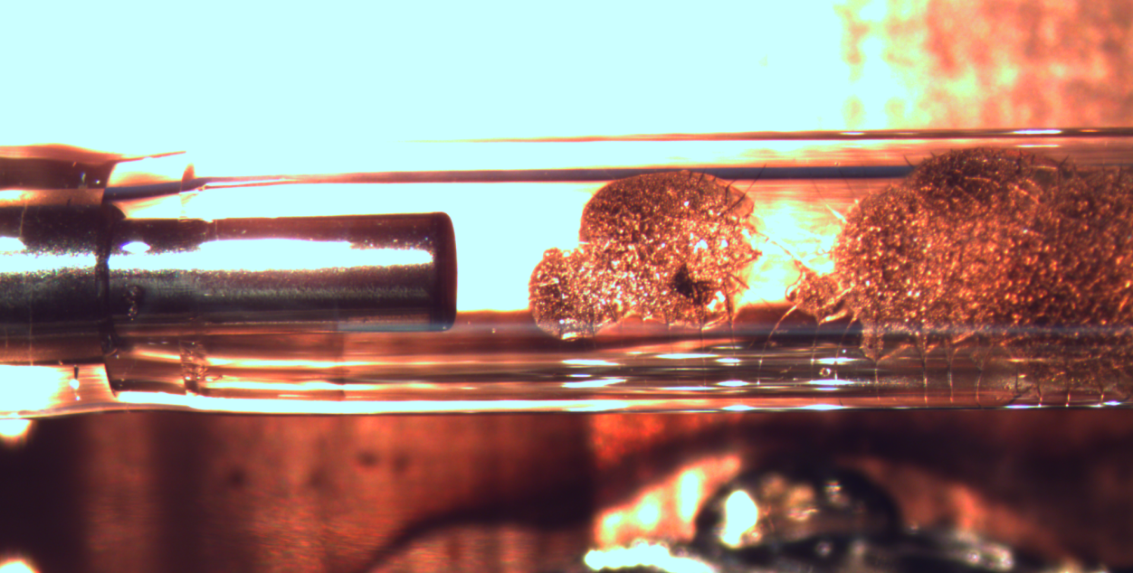
Original Housing and Bulb
Bulb after 100,000 flashes

Slide 20
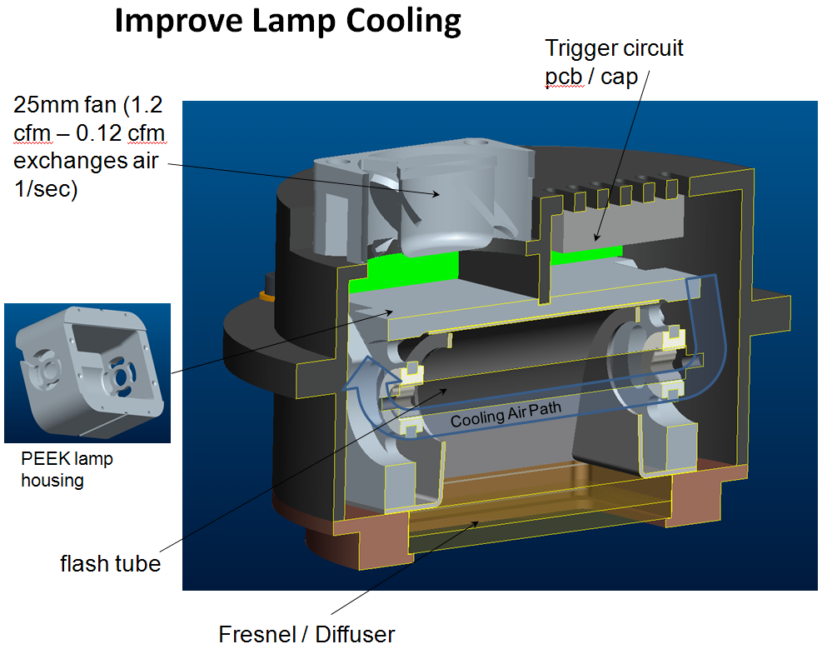
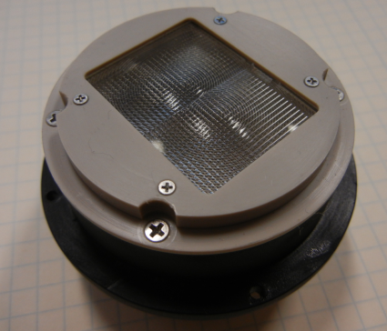
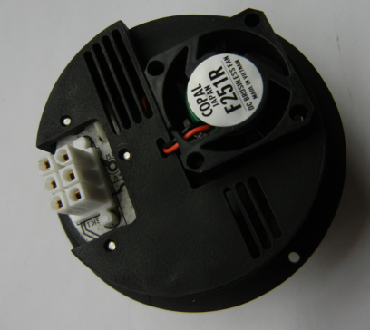
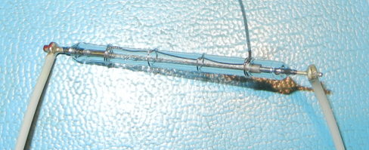
Improved Housing and Bulb in Test
Air flow cooling and larger housing
Switch from borosilicate to quartz glass
Improvements currently testing at an average life of 165, 000 flashes

Slide 21
Bulb Replacement
Bulb housing module designed for easy removal from front of canister at 15 meter height

Slide 22
Summary
Cryogenic photogrammetry system with
3.4 m radius windmill boom
+/- 60° pan range
+ 60° / - 75° tilt range
90° camera roll
Radiation reduced for sensitive JWST
< 1 milliwatt heat
< 1 microwatt within the passband of the MIRI selected filter
Flash life increased from 64 k to 165 k flashes
100 k flashes planned

