Slide 1
Status of the James Webb Space Telescope
Integrated Science Instrument Module
Ray Lundquist, NASA GSFC

Slide 2
Collaborators
Michael P. Drury
Jamie L. Dunn
Stuart D. Glazer
Matthew A. Greenhouse
Ed Greville
Gregory Henegar
Eric L. Johnson
John C. McCloskey
Raymond G. Ohl
Pam Davila
Robert A. Rashford
Gurnie C. Hobbs
Scott Lambros
Doug McGuffey
Mark F. Voyton
Vicki Balzano

Slide 3
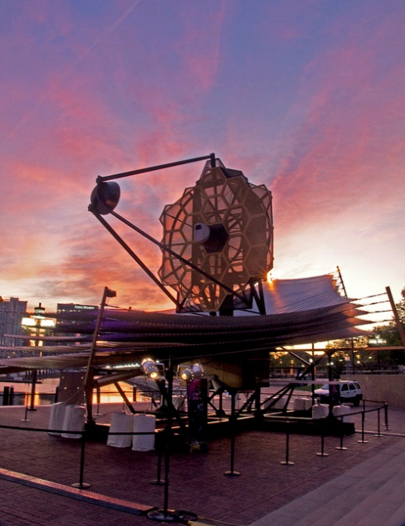
JWST Full Scale Model at the Baltimore Inner Harbor

Slide 4
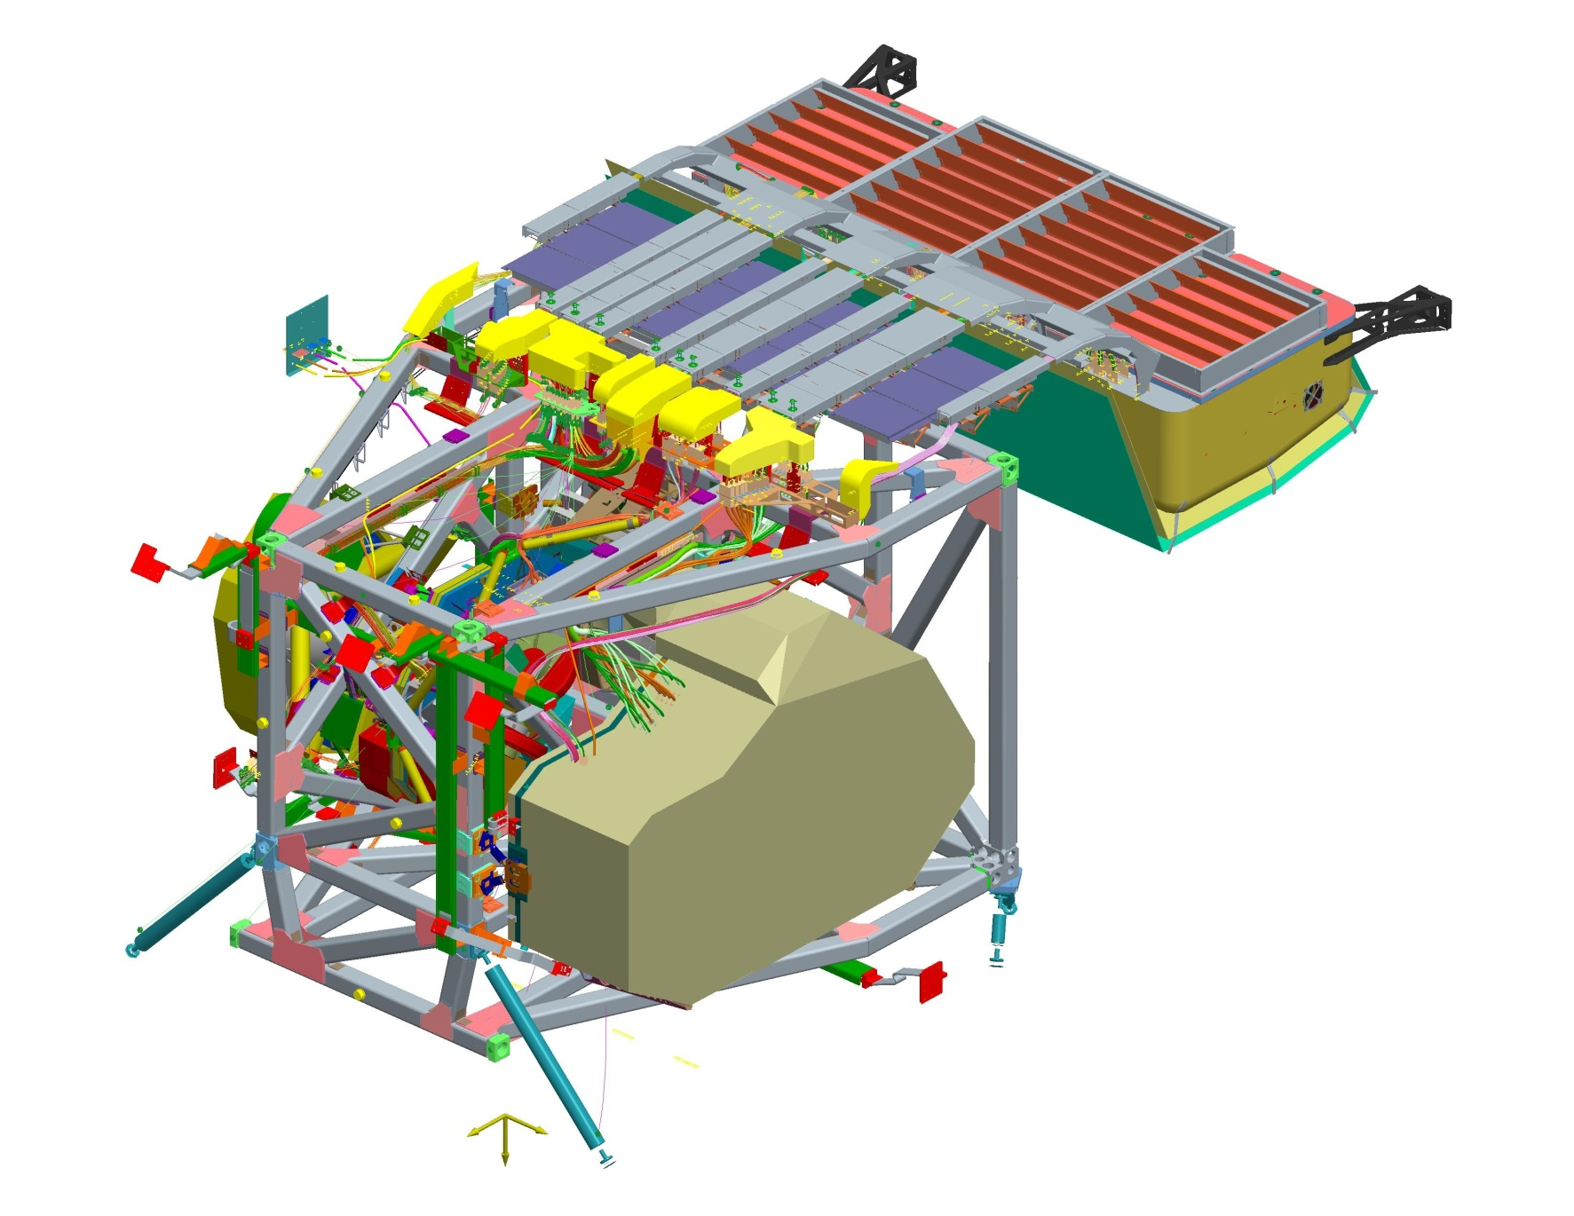
ISIM Subsystems
The Integrated Science Instrument Module contains
  Four Science Instruments
    NIRCam; NIRSpec; MIRI; and FGS/NIRISS
  And the supporting Infrastructure
    Primary Structure
    ISIM Electronics Compartment (IEC)
    Harness Radiator (HR)
    ISIM Command and Data Handling (ICDH)
    ISIM Remote Services Unit (IRSU)
    Thermal Control System (TCS)
    ISIM Flight Software (IFSW)
    On-Board Script System
    And Electrical Harnessing
Radiator Baffle
Purge Lines and GSE Panel
Electrical
Harness and Harness Radiator
MIRI
IEC
Harness Radiator
NIRCam
ISIM Structure
NIRSpec
Kinematic Mount
Thermal Straps

Slide 5
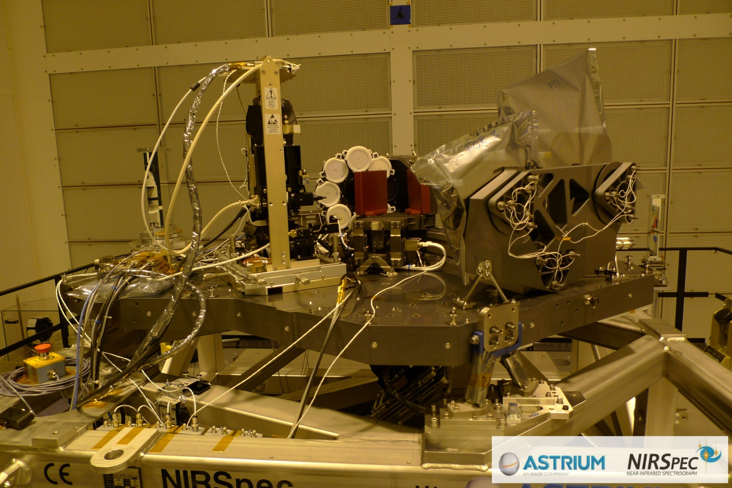
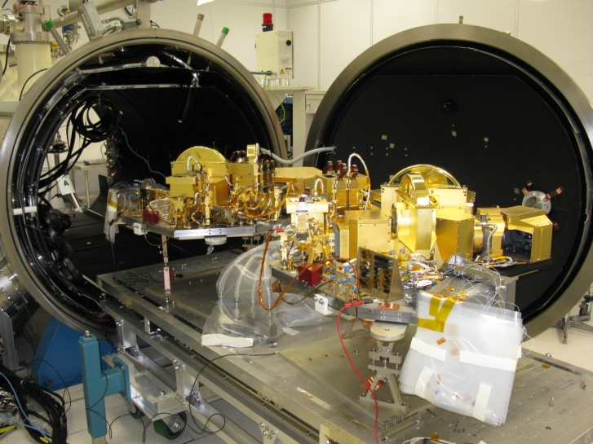
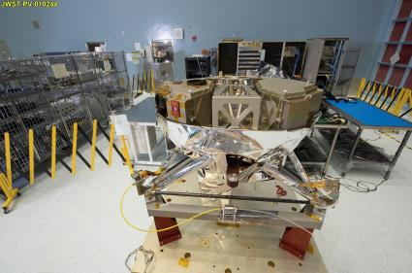
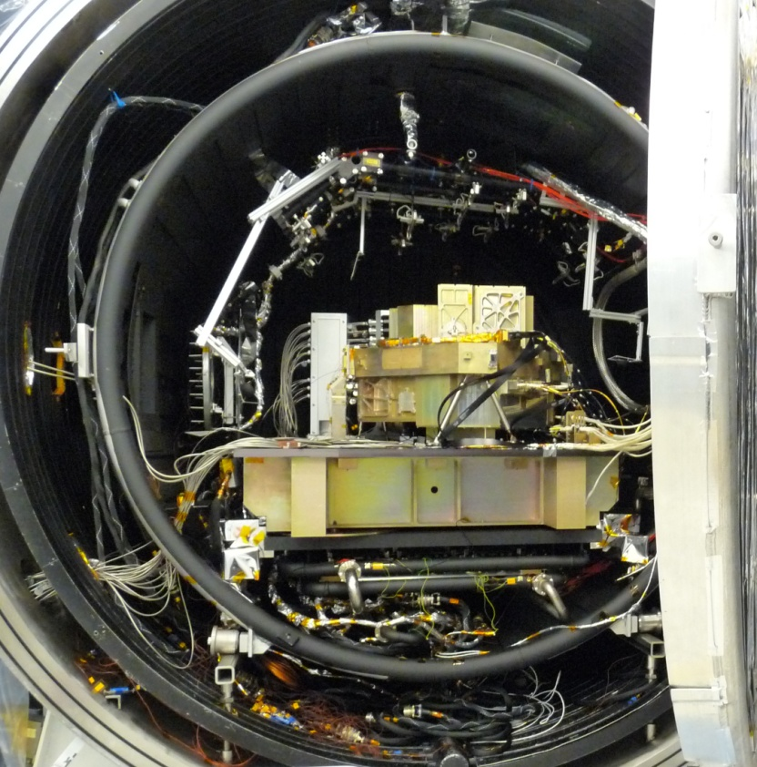
Instruments are being tested and delivered
NIRCam starting vacuum testing
NIRSpec fully tested, but re-build is needed
MIRI Completed testing and delivered to Integration and Test
FGS completing vacuum testing and ready for delivery

Slide 6
Instrument Status
Instrument | Current Testing | Upcoming Test | Delivery Date
NIRCam | Thermal/Cryo Vac | Second thermal test and vibration at GSFC | November 12
NIRSpec | Bench level assembly | Full test program | April 13
MIRI | Post ship functional | ISIM test program | Delivered (May 12)
FGS/NIRISS | Complete | ISIM test program | July 12
All NIR instrument detectors have a slow degradation process, called “hot pixels” which impacts sensitivity. Replacement detectors are being procured and will be replaced prior to the final ISIM system level test

Slide 7
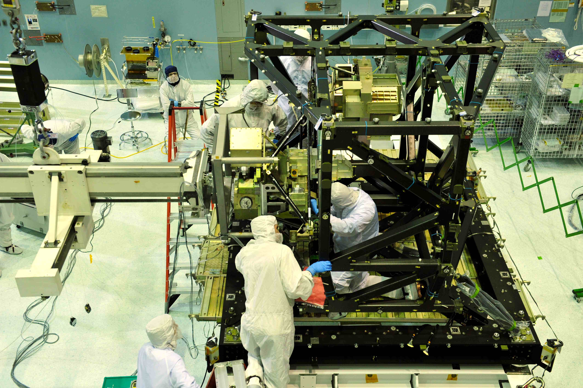
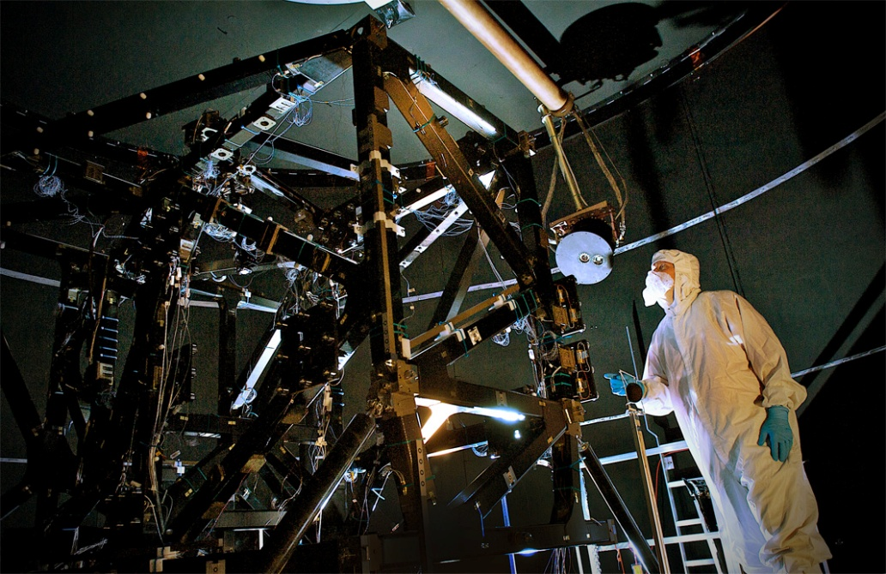
Structure
Structure delivered to I&T in 2011 after completing proof testing and cryo soak/cycle to survival temperatures
Fit check of MIRI STM and FGS ETU

Slide 8
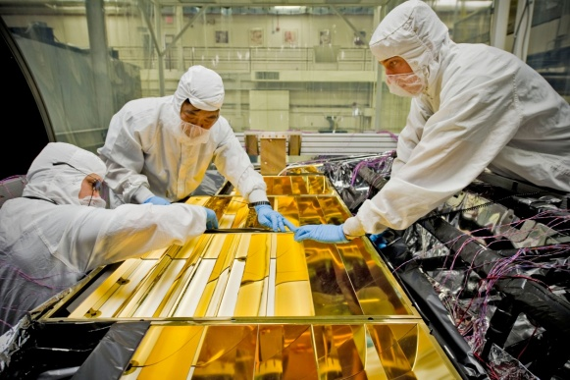
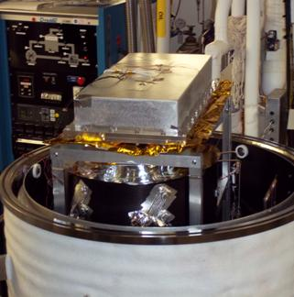
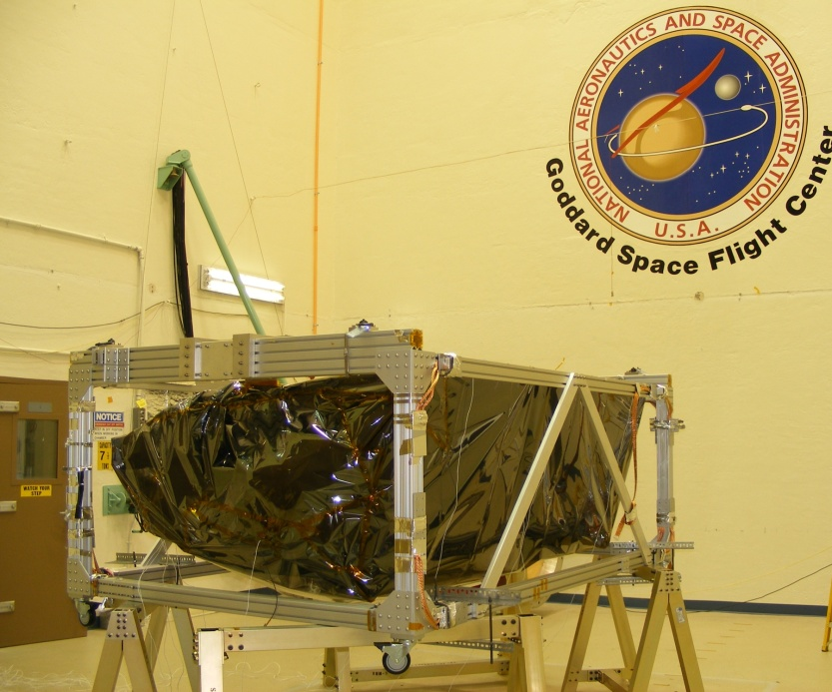
IEC Progress
Preparation for IEC thermal balance test
Thermal balance and moisture capture test of the IEC vent
IEC ready for acoustics test

Slide 9
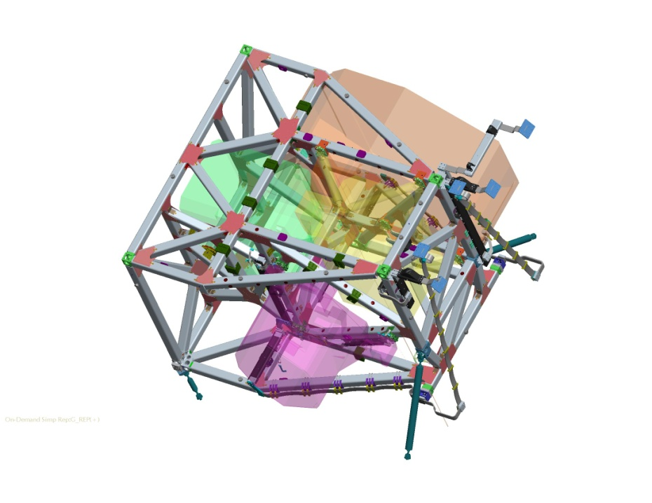
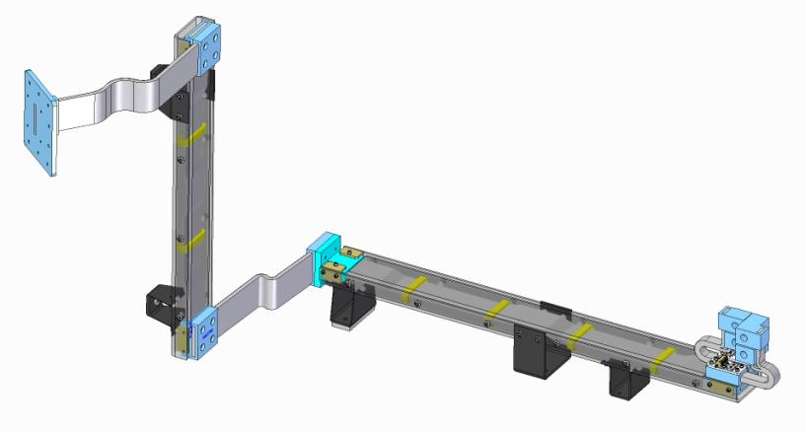
Thermal Control System
NIRS-5
Assembly
NIRSpec OA Strap - Example
NIRS-4
Assembly
NIRS-1A
NIRS-1B
NIRS-3
Assembly
NIRS-2
Assembly
Update to heat strap routing following the Return-to-Green effort
13 of 30 heat straps systems have been delivered to ISIM

Slide 10
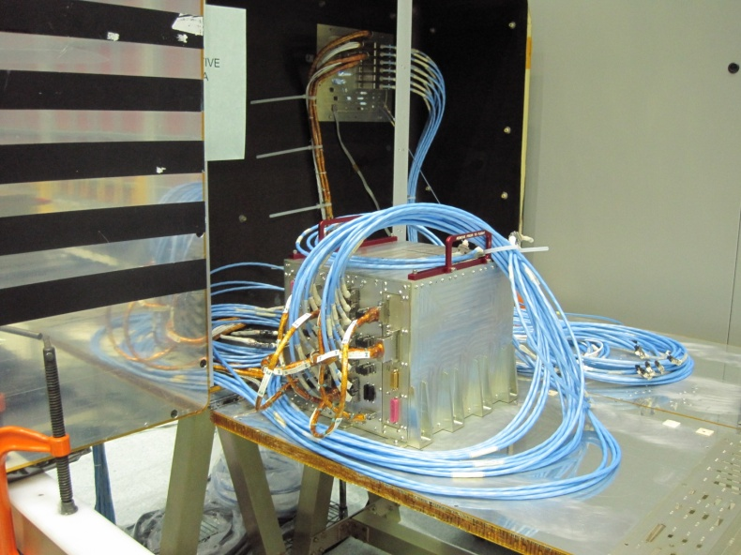
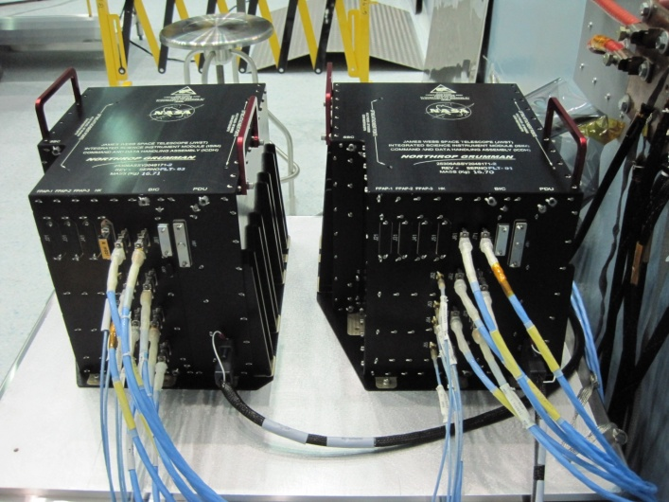
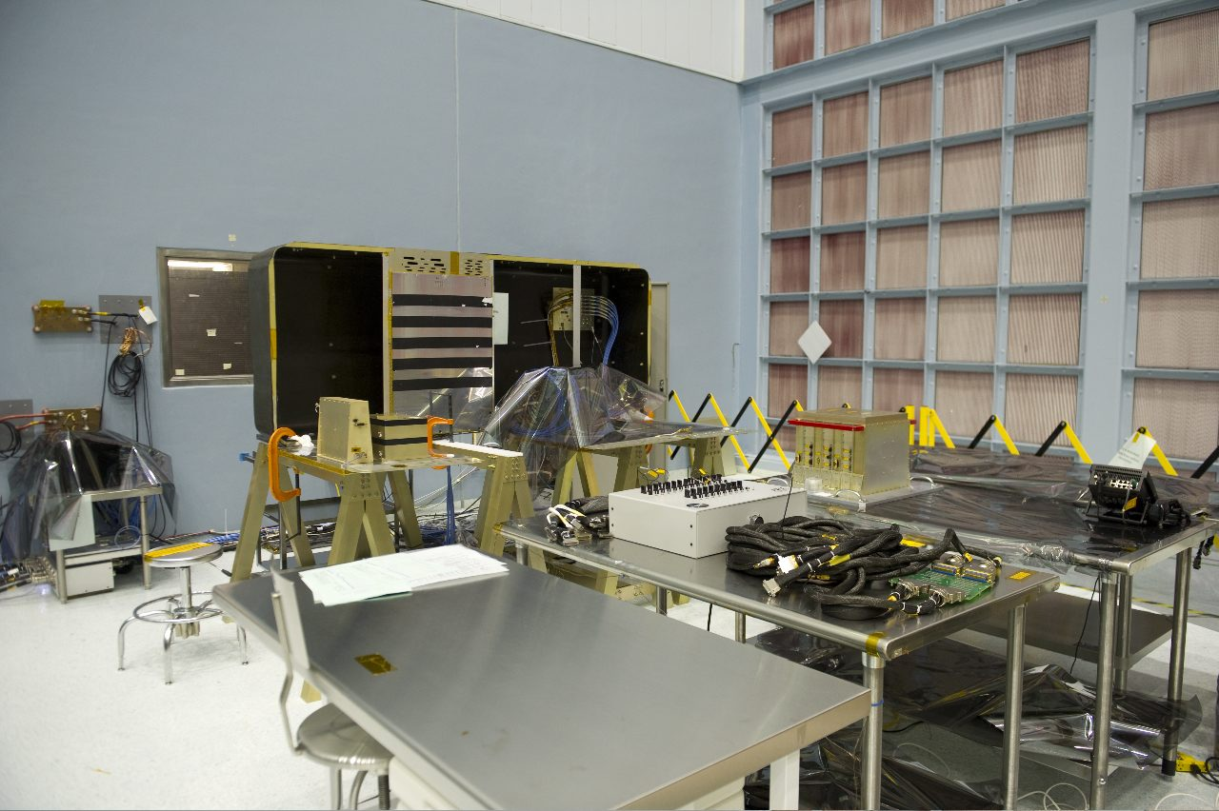
Electronics
Both ISIM command data handling (ICDH) units are delivered. They have completed integration testing and are ready to support ISIM integration and test
ISIM remote services unit (IRSU) has been delivered and are undergoing integration verification testing

Slide 11
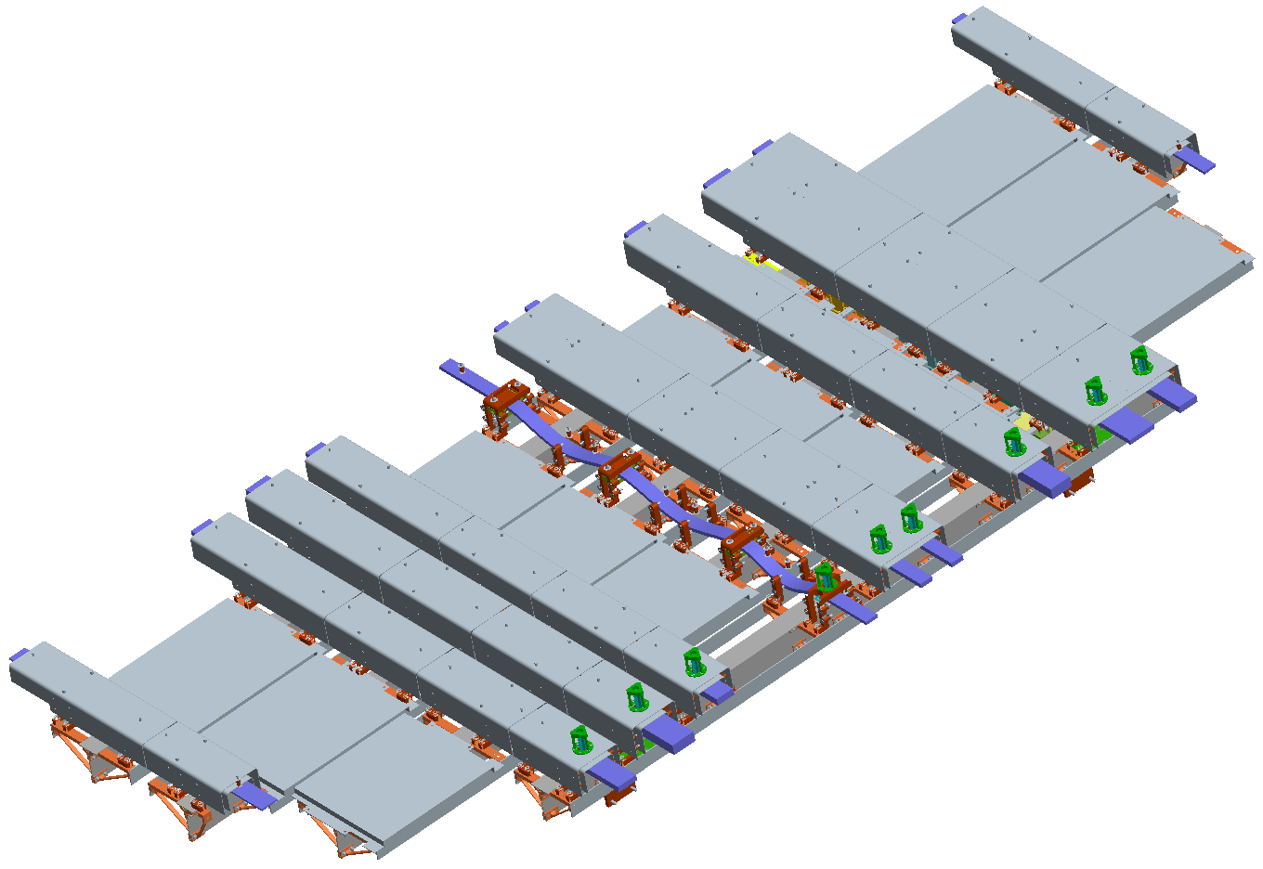
Harnesses and Harness Radiator
Two-layer Aluminum meteoroid shields; outer layer is radiating surface
Aluminum Radiator Panels
IEC (hot)
Electrical harnessing
  All detector interface harnesses complete and delivered
  Flight or test versions of all instrument interface cables have been completed. Final flight builds are continuing.
Sis – cold side
Meteoroid shield removed to show harness routing/clamps
No assembly picture yet
All piece parts received and assembly has begun

Slide 12
Software
ISIM Flight Software
  Core software build 12.6 is complete and tested
  Initial version of all Science Instrument software applications have been successfully integrated with the Core
  Updated versions of instrument software expected with instrument delivery
  Modification of detector read-out schemes under investigation to reduce/improve system noise

Slide 13
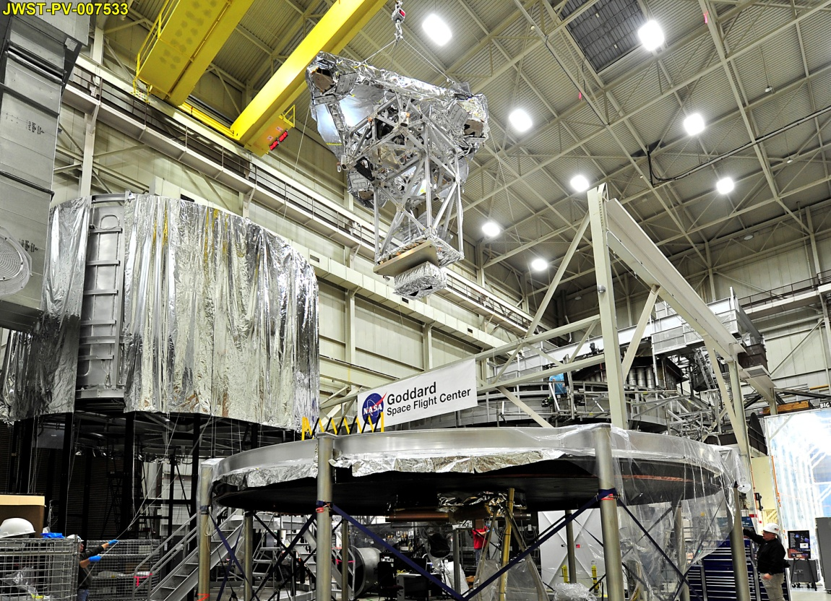
Test Systems
Optical simulator (OSIM) being installed in the test chamber

Slide 14
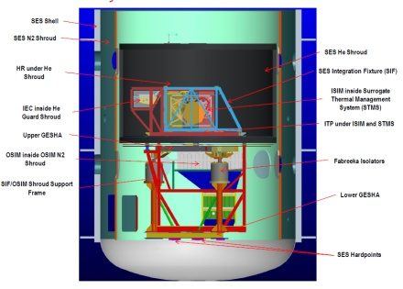
Test Systems
ISIM level full system test configuration

Slide 15
Summary
ISIM subsystem development is progressing well
First cryo-vacuum test planned for March 13, without NIRSpec. Two cryo-thermal tests planned with NIRSpec
NIR detector replacement plans are being developed
Test equipment, facilities, and plans are in place for a successful ISIM test program

