Slide 1
NIRCam:
A Revolutionary
Near-IR Capability with JWST
Charles A. Beichman, Marcia Rieke, Daniel Eisenstein, Thomas P. Greene, John Krist
Don McCarthy, Michael Meyer, John Stansberry
And the NIRCam Team
SPIE, Amsterdam
July 06, 2012

Slide 2
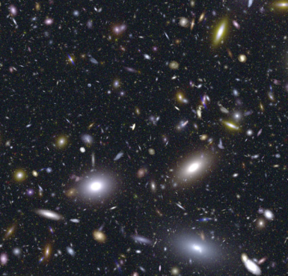
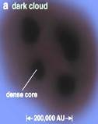
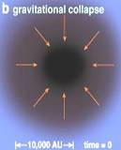
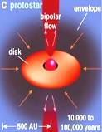
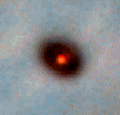

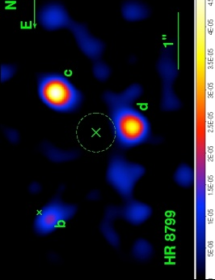
Science Goals Require 1-5 μm Performance
  First Light and Reionization: Conduct deep surveys to find and categorize objects.
  Broadband, high sensitivity, large FOV, diffraction-limited PSF, multiple broadband filters
  The Assembly of Galaxies: Measure shapes and colors of galaxies, identify young clusters
  Broadband, high sensitivity, large FOV, diffraction-limited PSF
Modern Universe
Quark Soup
Modern Universe
Quark Soup
Forming Atomic Nuclei
Inflation
Forming Atomic Nuclei
Inflation
Clusters &
First Galaxies
Clusters &
First Galaxies
Morphology
Reionoization
Morphology
Recombination
Reionoization
Recombination
NIRCam
NIRCam
NIRCAM_X000
  The Birth of Stars Planets: Determine colors and numbers of stars in clusters, measure extinction profiles in dense clouds
  Broad and narrowband filters, high sensitivity, large FOV, diffraction-limited PSF, high dynamic range
  Planetary Systems and the Origins of Life:
  Characterize disks and planets, classify KBOs
  Broad and intermediate band filters, high sensitivity, coronagraphic masks, defocused images and grism spectroscopy for transits

Slide 3
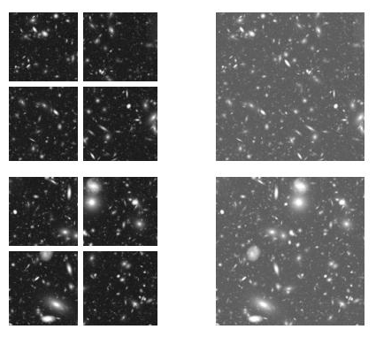
NIRCam: Simple but Powerful Capability
NIRCam images 0.6 - 5μm with refractive optics
  Dichroic splits into short (0.6-2.3 μm) and long-λ (2.4-5 μm) sections
  Nyquist sampling at 2 μm (0.032”/pix) & 4 μm (0.064”/pix)
  2.2 arcmin x 4.4 arcmin FOV in two colors (40 Mpixels) simultaneously
2 redundant modules
Coronagraphs
Grism and defocus lenses for science and WFS
Short wavelength channel
Long wavelength channel
Module A
Module B
2.2’

Slide 4
NIRCam Filters Span 0.65 - 5 μm
For Photo-z , ISM and Mineralogy
P
P
P
P
P
P
P
λ (μm)

Slide 5
NIRCam’s Revolutionary Capabilities
Sensitivity
  At 1-2 μm JWST is 3-4 mag more sensitive than Keck w. AO and 1-2 mag more sensitive than HST
  At 3-5 μm JWST is 8-10 mag more sensitive than Keck and 5 mag more sensitive than Spitzer/IRAC (with no confusion limit)
Stable high resolution PSF (<0.2” at 4.4 μm) over 4.4’ field
JWST/ NIRCAM | Point Source | Keck NIRC-2 with NGS AO | Point Source | WFC3/IR or IRAC | Point Source
F115W | 27.5 mag | J (Strehl=0.2) | 24.4 mag | F110W | 26.5
F150W | 27.5 mag | H (Strehl=0.3) | 23.9 mag | F160W | 25.5
F200W | 27.3 mag | Ks (Strehl=0.5) | 23.7 mag
F300W | 26.1 mag | L' (Strehl=0.6) | 18.1mag | IRAC 3.6 | 21.2
F444W | 25.1 mag | M (Strehl=0.6) | 15.6 mag | IRAC 4.5 | 20.4
(Vega mag, 5σ, 1hr)

Slide 6
Key Science Programs: First Light
NIRCam is 100x more sensitive Spitzer for ultra-deep surveys for youngest galaxies (z~10)
  Multi-Filter set for ~4% photometric redshifts for >98% of galaxies in multi-color survey.
M_{AB}=30
Z=5
Z=10
λ (μm)
The z=10 galaxy has a mass of 4x10⁸M_{Sun}
Assumes 50,000 sec/filter with 2x time on longest wavelength

Slide 7

Key Science Programs: Assembly of Galaxies
HST+ WFC3 resolution
NIRCam’s combination of sensitivity and angular resolution will reveal how galaxies develop their characteristic shapes.
JWST+NIRCam resolution

Slide 8
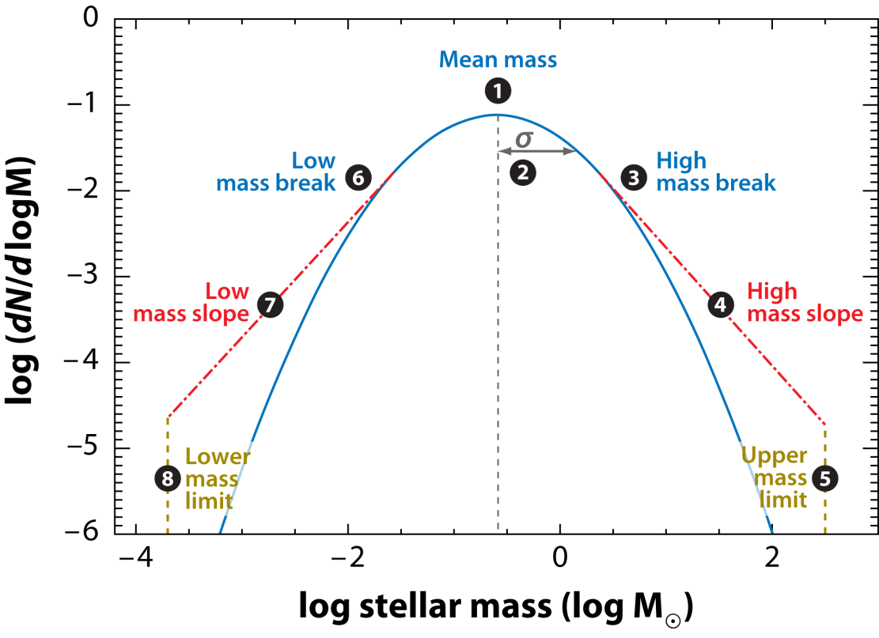
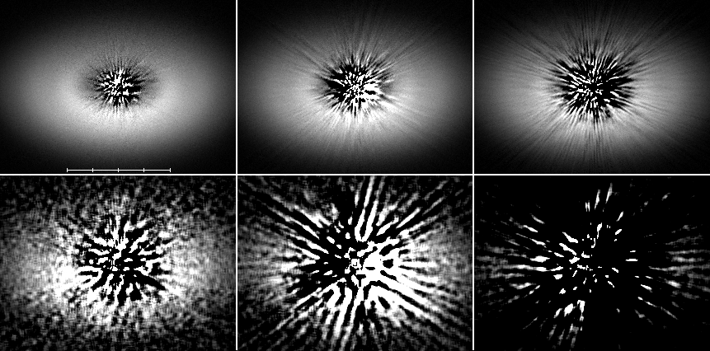
Key Science Programs: Star And Planet Formation
Star formation: Near & Far
  Closest clusters (140-500 pc) to probe low mass IMF (1 Jupiter mass)
  Most distant clusters (MW,LMC,SMC,Local group ) to probe high mass IMF
  Cluster dynamics from NIRCam proper motions and RV at <1 km/s level
Bastian, Covey, Meyer 2010
5 20 40 nm
Disk Evolution:
  Probe protostellar and debris disks
  Look for rings, gaps, planets?
  Map dust, ice distribution
3x β Pic
0”
4”
Disk/50

Slide 9
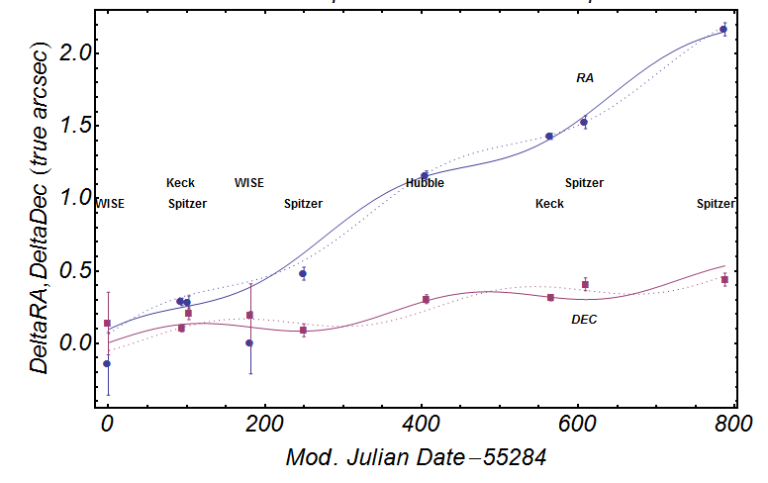
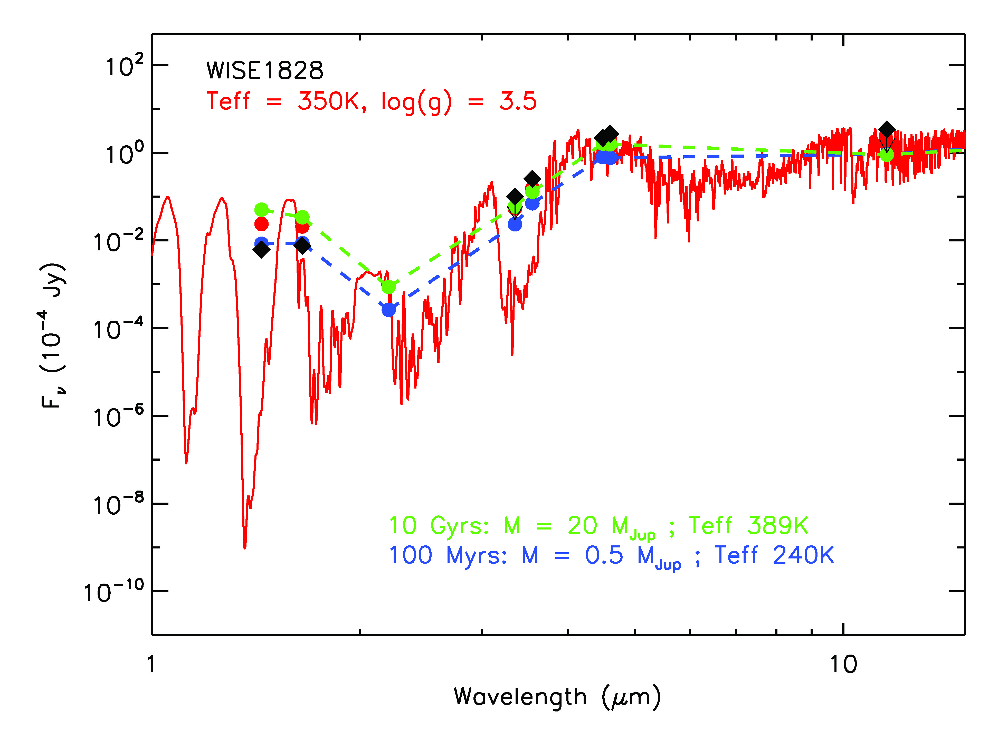
Nearby Y Dwarfs: The Closest Planets?
D~10 pc
WISE & Spitzer objects
  T < 500 K
  Mass ~1-20 M_{Jup}
  Ages ~0.1-5 Gyr
  Distances < 20 pc
Astrometry and binarity
  100-200 mas parallax and 10s mas orbital motions easily detectable w. many ref stars
Bright sources (>100 μJy)
  Grism and NIRSpec spectra
  Compare with spectra of bound planets formed via disk fragmentation

Slide 10
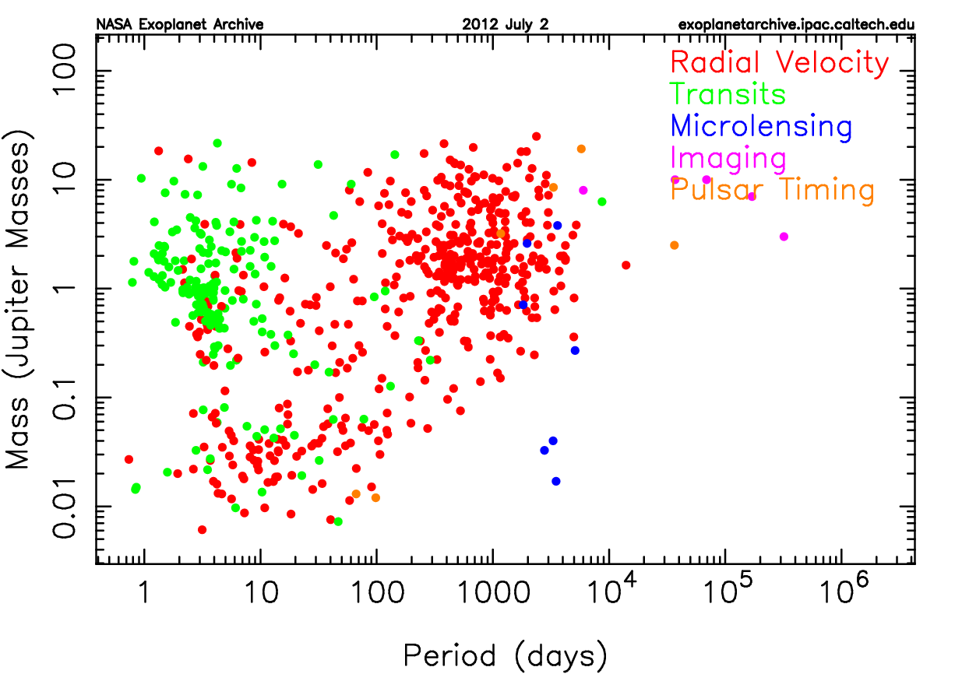
Key Science Programs: ExoPlanet Science
Transit Follow-up
Imaging Searches & Follow-up
Notes:
10

Slide 11
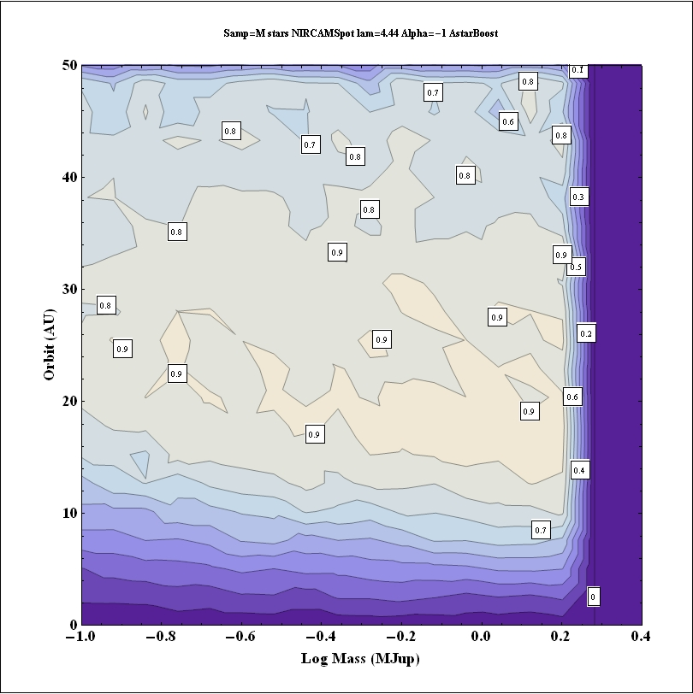
NIRCam Planet Imaging
NIRCam good match to hot young planets, but poor coronagraphic performance wrt. ExAO on ground
Leave surveys of bright stars to ground-based 8-10 m telescopes (131 nm vs 5 nm of WFE w. ExAO)
  Use JWST for surveys of faint, young M stars with sensitivity to planets M> 0.1 MJup at 15-35AU
GTOs will characterize ~15 systems
  Complete SEDs (NIRCam + MIRI)
  Refine orbits w. HST, ground-based
  Search for additional planets (>M_{Saturn})
  Investigate interactions with rings, incl rings inferred from Spitzer SED
Photons cm⁻² sec⁻¹ mm⁻¹
80-90% complete
Beichman et al 2010

Slide 12
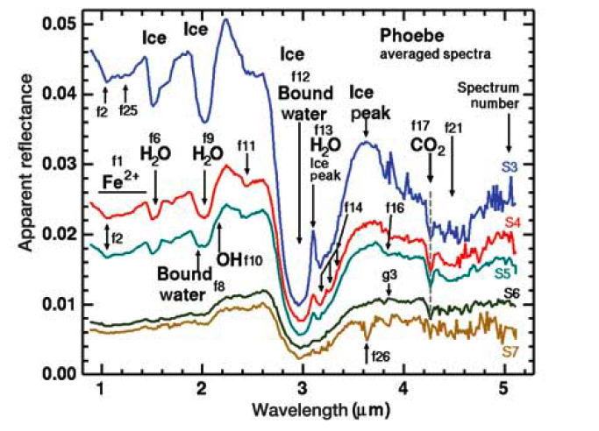
Key Science Program: Properties of Kuiper Belt Objects
Spectra from D = 220 km “KBO”, Clark et a 2005
Phoebe
Filter photometry of dozens of KBOs with d>100 km at R~100 to investigate surface properties
Astrometry for binaries ➔ mass & density

Slide 13
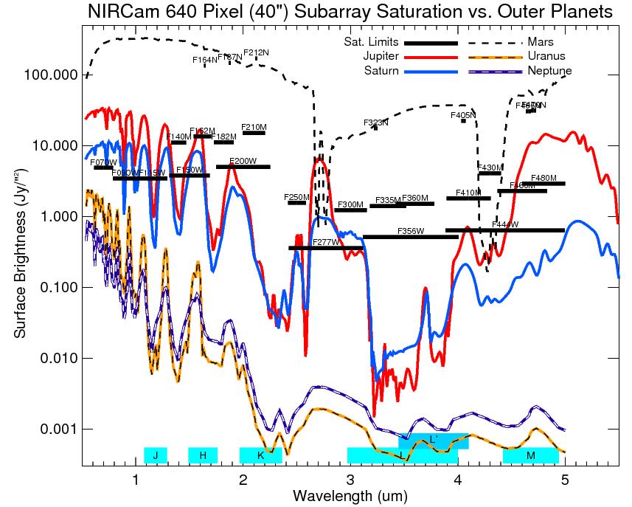
JWST Will Study Outer Planets (Even Mars!)

Slide 14
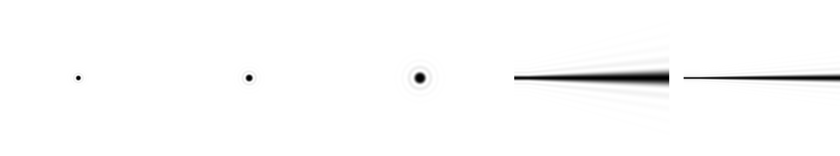
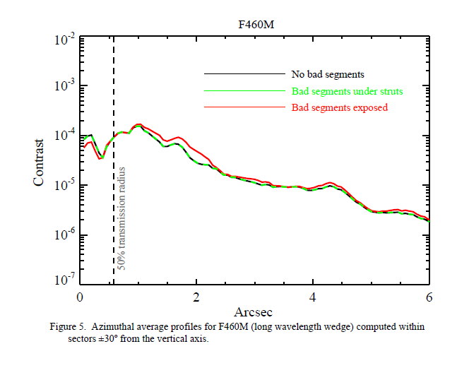
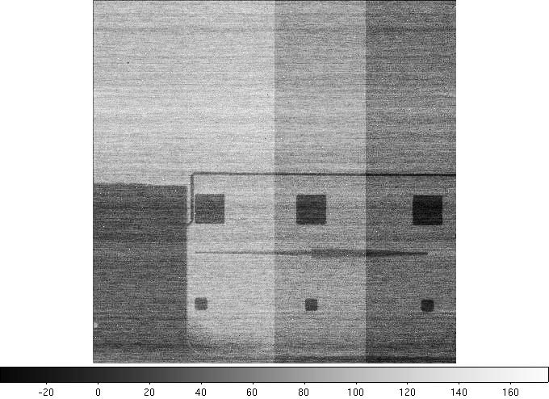
Coronagraph Status
5” x 5” ND squares
20” (~12 mm)
HWHM=2λ/D
HWHM=6λ/D
HWHM = 0.40”
(6λ/D @ 2.1 μm)
HWHM = 0.64”
(6λ/D @ 3.35 μm)
HWHM = 0.82”
(6λ/D @ 4.3 μm)
HWHM_{c} = 0.58”
(4λ/D @ 4.6 μm)
HWHM_{c} = 0.27”
(4λ/D @ 2.1 μm)
Krist 2011
FIRST Light for NIRCam

Slide 15
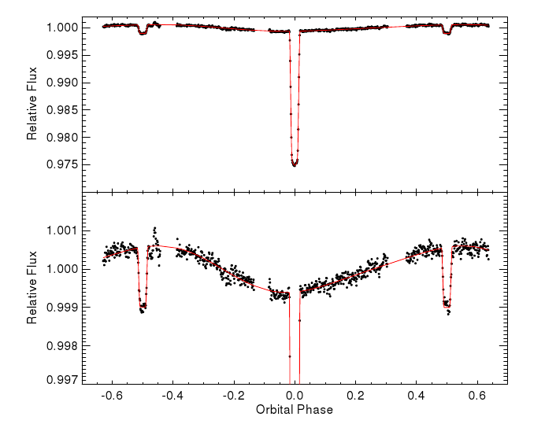
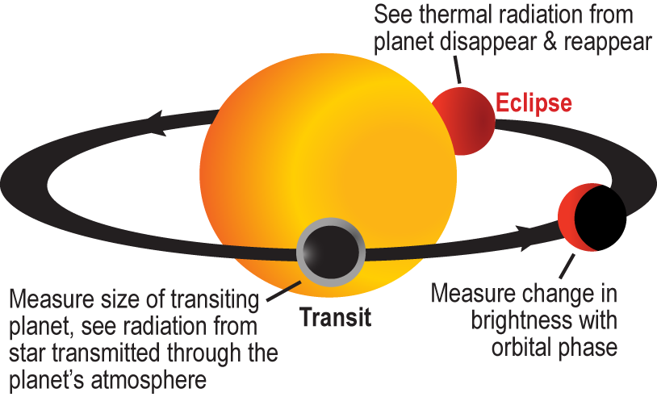
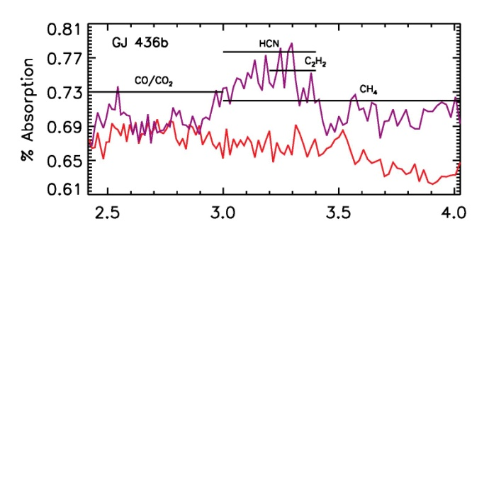
JWST Transit Science
Knutson et al. 2012
High SNR/precision photometry & spectra from L2 orbit will revolutionize transit observations: 7.6xSNR(Spitzer), 2.7xSNR(HST)
Wide spectral coverage (0.5-20 μm) and resolution (R~5-2,000)
NIRCam/NIRIS grisms & NIRSpec will characterize atmospheres, e.g. metallicity & photochemsitry
Relative flux
Uranus orbiting M3 star

Slide 16
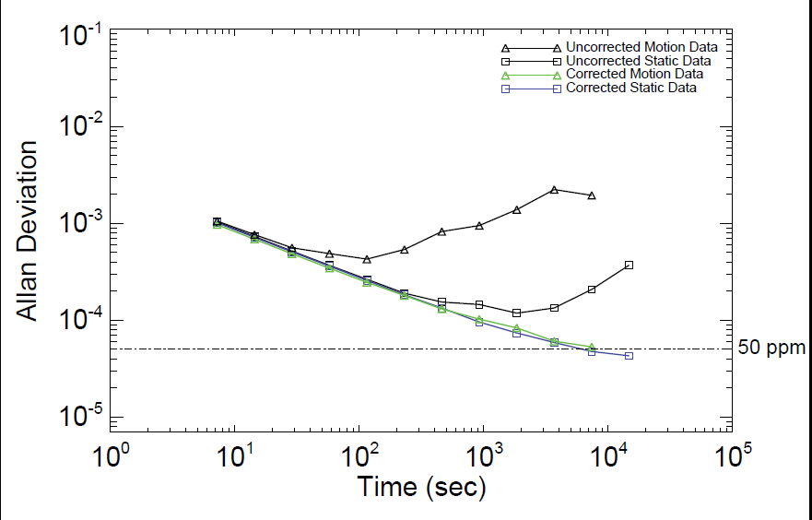
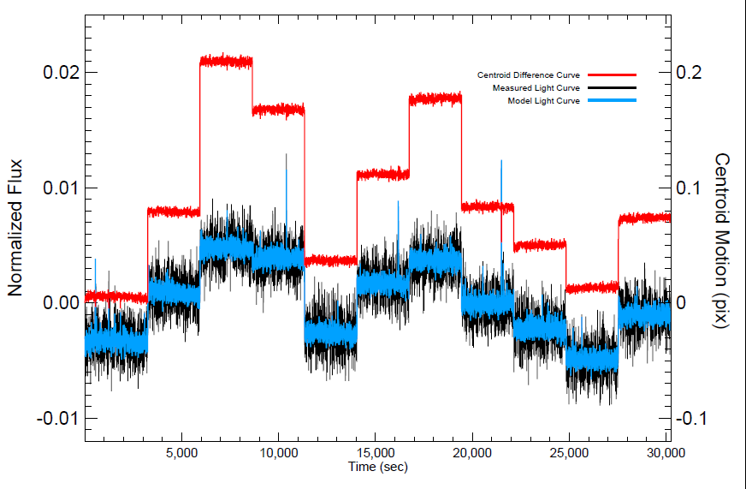
Transit Measurements Require Extreme Precision
Clanton et al 2012
H2RG device similar to JWST detectors show noise performance <50 ppm in presence of jitter and other disturbances
Jitter
Motion
Experiments show jitter rejection (0.25 pixel) to <<50 ppm
Monitoring reference stars in one NIRCam arm while taking data with grism or defocus lenses will allow decorrelation of jitter noise
Intensity
and PCA Model

Slide 17
Direct Simulation of Transit Observations
Star
Lamp 1
Lamp 2
Mask 1
Planet
>40mm square field
ND Filter
10,100,1000
Beam Combiner
Mask 2
100 mm pupil
f/8 beam to detector.
12 um diffraction spot vs. 18 um pixel
Detector

Slide 18
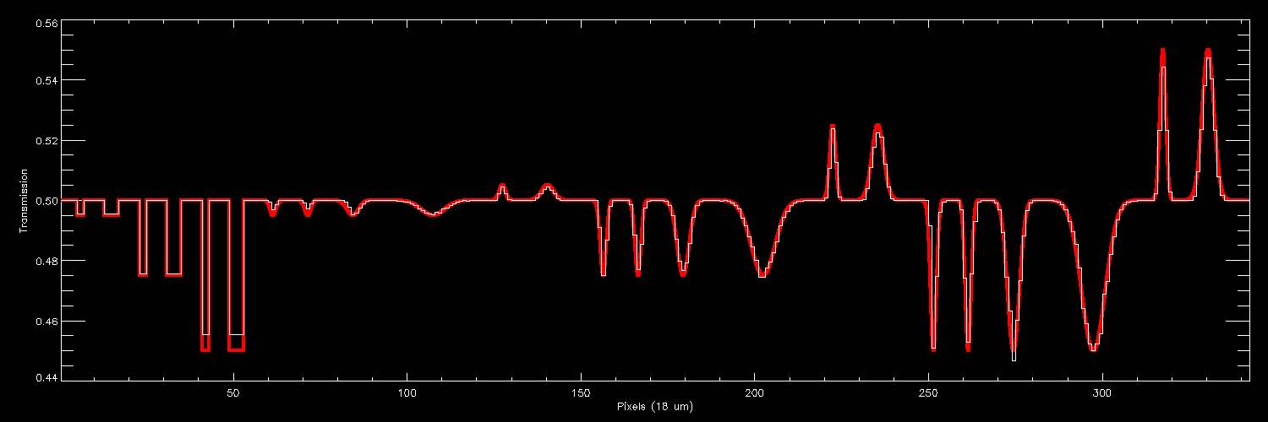
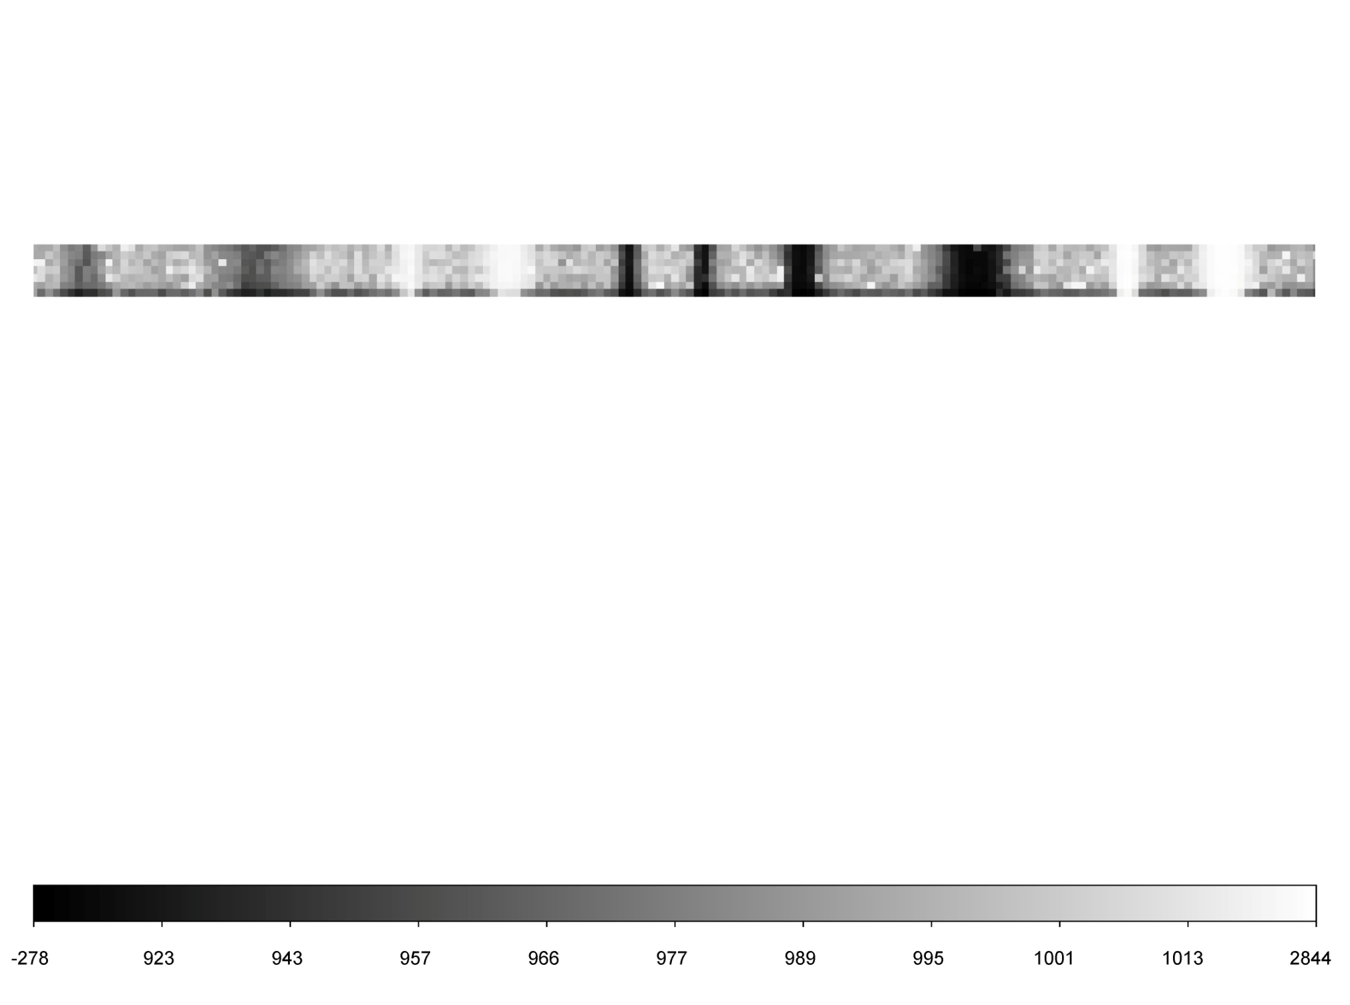
New Spectral Line and Photometric Simulation Masks
Designed by John Krist and fabricated at JPL MDL (similar to JWST coronagraphic masks)

Slide 19
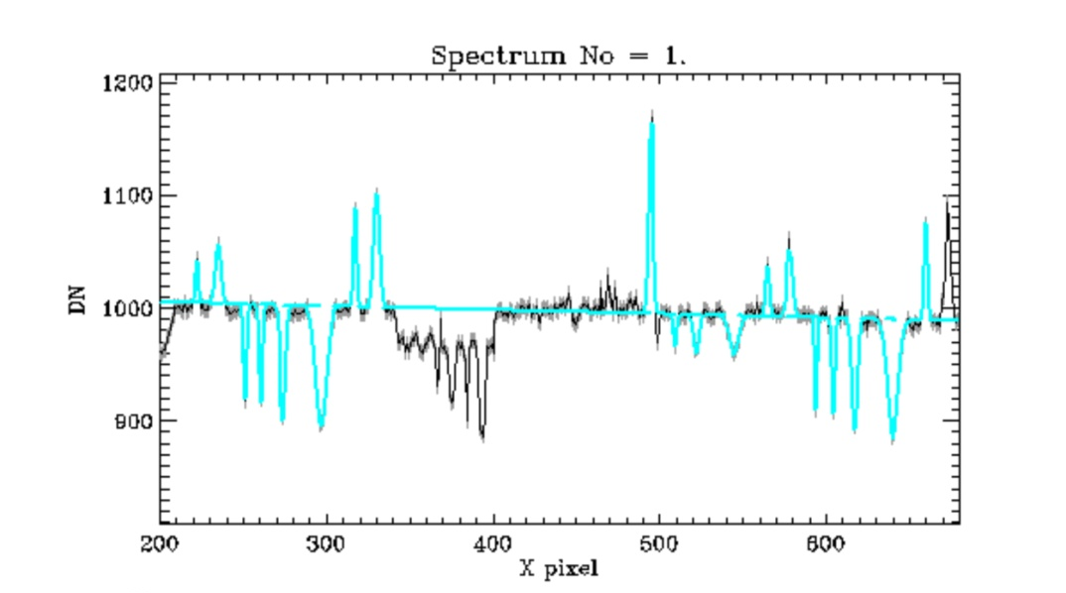
First Light With JWST
Planet Spectrum Testbed
Set Planet and Star brightness independently
Take 100s-1000s of exposures to demonstrate photon noise limited measurements at <<50 ppm, e.g. S=10,000/P=10 and find ~10% features
Make controlled series of 1-10 μm (~0.5 pixels) steps to quantify and mitigate pointing jitter
Develop algorithms for JWST and FINESSE Explorer

Slide 20
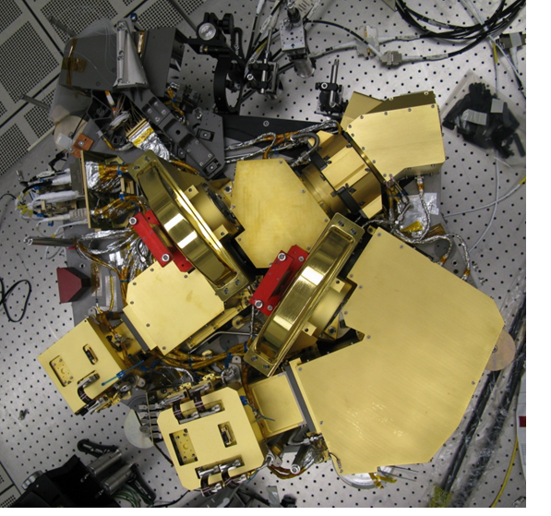
Pickoff Mirror
Coronagraph
Collimator
Dichroic
NIRCAM Now in Pre-Delivery Cold Test at LM
Short-λ Lens
Long-λ
Lens
Long-λ FPA
Pupil
Lens
Short-λ FPA

Slide 21
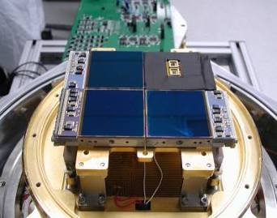
Near IR Detectors
NIRCam, NIRSpec & FGS use the same HgCdTe detectors.
NIRCam uses 2.5 μm and 5.2 μm cut-off material.
Format is 2040x2040 with 4 reference pixels around the periphery
Performance is excellent– dark current at 37K is ~.005 e/sec, QE > 80% over 0.6–5 μm
Read Noise: median is 7.5 electrons in 1000 sec.
Well depth is nearly 2x the required 60,000 electrons.

Slide 22
Replacement Detectors Being Fabricated to Fix Hot Pixel Problem
Property | Require-ment | New Short-Wavelength Detector | Range for 8 Old Short-wavelength Flight Detectors
Dark Current at 39.5K (e-/sec) | 0.010 | 0.008 | 0.0018-0.009
CDS Read Noise (e-) | 21 | 20.3 | 15.9-20.5
Noise in 1600s (e-) | 9.0 | 7.6 | 4.9-6.7
Well Depth (e-) | 60,000 | 104,000 | 98,300 – 107,000
QE at 2 microns | 0.80 | 0.81 | 0.80-0.99

Slide 23
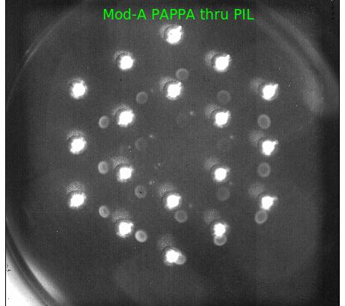
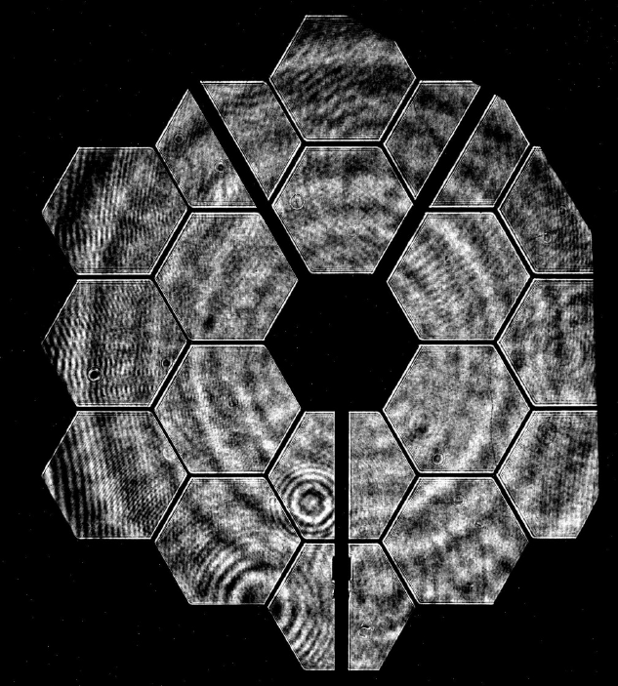
NIRCam Ready To Go
NIRCam is now fully assembled and being tested at Lockheed Martin for delivery to GSFC in the Fall
All critical performance requirements have been met or exceeded including optical and detector efficiency (→sensitivity)
Subsystem tests and analysis suggest WFE will meet 69 nm reqmt over > 80% of FOV
Pupil imaging lens deploys correctly and the internal sources work – ghosts because the images are overexposed.
The OMA telescope simulator is not yet aligned, but focus and PIL repeatability is excellent (~0.1 pixel) vs. reqmt of 8 pixels)!
Improved detectors will be retrofitted in 2014

